Slide 1
Theory of Automata Context Free Grammars
Week 8

Slide 2
Contents
Simplification of CFGs
Killing Λ-Productions
Killing unit-productions
Removing Useless Variables
Symbols & Productions
Augmented Grammar
Removal of Left Recursion
Expression Grammar
Left Factoring

Slide 3
Killing Λ-Productions
Λ-Productions:
In a given CFG, we call a non-terminal N nullable
if there is a production N → Λ, or
there is a derivation that starts at N and lead to a Λ.
N ➔ ……… ➔ Λ
Λ-Productions are undesirable.
We can replace Λ-production with appropriate non-Λ productions.
Notes:
3

Slide 4
Theorem 23
If L is CFL generated by a CFG having Λ-productions, then there is a different CFG that has no Λ-production and still generates either the whole language L (if L does not include Λ) or else generate the language of all the words in L other than Λ.
Replacement Rule.
Delete all Λ-Productions.
Add the following productions:
For every production of the X → old string
Add new production(s) of the form X → .., where right side will account for every modification of the old string that can be formed by deleting all possible subsets of null-able Non-Terminals, except that we do not allow X → Λ, to be formed if all the character in old string are null-able
Notes:
4

Slide 5
Example
Consider the CFG
S → a | Xb | aYa
X → Y | Λ
Y → b | X
X is nullable
Y is nullable
Old nullable New
Production Production
X → Y nothing
X → Λ nothing
Y → X nothing
S → Xb S → b
S → aYa S → aa
So the new CFG is
S → a | Xb | aa | aYa |b
X → Y
Y → b | X
Notes:
5

Slide 6
Example
Consider the CFG
S → Xa
X → aX | bX | Λ
X is nullable
Old nullable New
Production Production
S → Xa S → a
X → aX X → a
X → bX X → b
So the new CFG is
S → a | Xa
X → aX | bX | a | b
Notes:
6

Slide 7
Example
S → XY
X → Zb
Y → bW
Z → AB
W → Z
A → aA | bA | Λ
B → Ba | Bb | Λ
Null-able Non-terminals are?
A, B, Z and W
Notes:
7

Slide 8
Example Contd.
S → XY
X → Zb
Y → bW
Z → AB
W → Z
A → aA | bA | Λ
B → Ba | Bb | Λ
Old nullable New
Production Production
X → Zb X → b
Y → bW Y → b
Z → AB Z → A and Z → B
W → Z Nothing new
A → aA A → a
A → bA A → b
B → Ba B →a
B → Bb B → b
So the new CFG is
S → XY
X → Zb | b
Y → bW | b
Z → AB | A | B
W → Z
A → aA | bA | a | b
B → Ba | Ba | a | b
Notes:
8

Slide 9
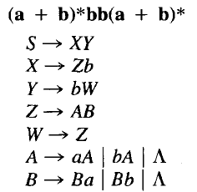
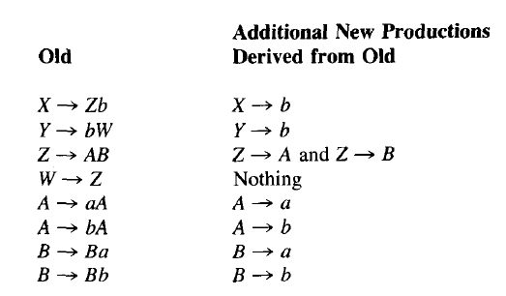
Remove Nulls

Slide 10
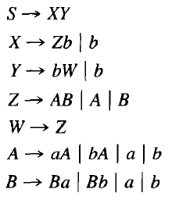

Slide 11
Killing unit-productions
Definition: A production of the form
non-terminal → one non-terminal
is called a unit production.
The following theorem allows us to get rid of unit productions:
Theorem 24:
If there is a CFG for the language L that has no Λ-productions, then there is also a CFG for L with no Λ-productions and no unit productions.
Notes:
11

Slide 12
Proof of Theorem 24
This is another proof by constructive algorithm.
Algorithm: For every pair of non-terminals A and B, if the CFG has a unit production A → B, or if there is a chain
A ➔ X₁ ➔ X₂ ➔ … ➔ B
where X₁, X₂, ... are non-terminals, create new productions as follows:
If the non-unit productions from B are
B → s₁ | s₂| …
where s₁, s₂, ... are strings, we create the productions
A → s₁| s₂| …
Notes:
12

Slide 13
Example
Consider the CFG
S → A| bb
A → B | b
B → S | a
The non-unit productions are
S → bb A → b B → a
And unit productions are
S → A
A → B
B → S
Notes:
13

Slide 14
Example contd.
Let’s list all unit productions and their sequences and create new productions:
S → A gives S → b
S → A → B gives S → a
A → B gives A → a
A → B → S gives A → bb
B → S gives B → bb
B → S → A gives B → b
Eliminating all unit productions, the new CFG is
S → bb | b | a
A → b | a | bb
B → a | bb | b
This CFG generates a finite language since there are no non-terminals in any strings produced from S.
Notes:
14

Slide 15
Useless Symbols
A symbol that is not useful is useless
Let a CFG G. A symbol x ε (V U ∑) is useful if there is a derivation
Where U and V ε (V U ∑) and w ε ∑*.
A terminal is useful if it occurs in a string of the language of G.
A variable is useful if it occurs in a derivation that begins from S and generates a terminal string
For a variable to be useful two conditions must be satisfied.
The variable must occur in a sentential form of the grammar
There must be a derivation of a terminal string from the variable.
A variable that occurs in a sentential form is said to be reachable from S.
A two part procedure is presented to eliminate useless symbols.
Notes:
15

Slide 16
Algorithm to remove useless symbols
PART-I
Identify variables that derive terminal strings
Remove non-terminals that do not derive terminal strings.
e.g. following grammar G = S → aS | A | C
A → a
B → aa
C → CB
Notes:
16

Slide 17
Example
S → aS | A | C
A → a
B → aa
C → CB
We can identify variables that derive terminal strings.
i.e. A → a B → aa
And S ➔A ➔ a TERM = {S, A, B}
But not C. thus C is useless
Notes:
17

Slide 18
Example
PART - II
Rename the grammar
GT = S → aS | A
A → a
B → aa
Now draw a graph and delete nodes not reachable from S.
As B is unreachable so delete it and the final grammar will be G_{V}=
S → aS | A
A → a
aa
a
S
A
B
Notes:
18

Slide 19
Useless Productions
Useless Production
Some derivations never terminate...

Slide 20
Another grammar:
Useless Production
Not reachable from S
Notes:
20

Slide 21
In general:
if
and w contains only terminals
then variable is useful
otherwise, variable is useless
Notes:
21

Slide 22
A production is useless
if any of its variables is useless
Productions
Variables
useless
useless
useless
useless
useless
useless
useless
Notes:
22

Slide 23
Removing Useless Productions
Example Grammar:
Notes:
23

Slide 24
First:
find all variables that can produce
strings with only terminals
Round 1:
Round 2:
Notes:
24

Slide 25
Keep only the variables
that produce terminal symbols:
(the rest variables are useless)
Remove useless productions
Notes:
25

Slide 26
Second:
Find all variables
reachable from
Use a Dependency Graph
not
reachable
Notes:
26

Slide 27
Keep only the variables
reachable from S
(the rest variables are useless)
Final Grammar
Remove useless productions
Notes:
27

Slide 28
Set of variables that Derive terminal symbols
Input = CFG (V, ∑, P , S)
TERM = { A | there is a rule A→w ε P with w ε ∑*
repeat
PREV = TERM
For each variable in A ε V do
If there is a rule A → w and w ε (PREV U ∑)* then
TERM = TERM U {A}
Until PREV = TERM
Notes:
28

Slide 29
Example
Consider following CFG
G: S → AC | BS | B
A → aA | aF
B → CF | b
C →cC | D
D →aD | BD | C
E → aA | BSA
F → bB | b
Notes:
29

Slide 30
S → AC | BS | B
A → aA | aF
B → CF | b
C →cC | D
D →aD | BD | C
E → aA | BSA
F → bB | b
New Grammar from
TERM will be
G_{T}:
S →BS | B
A → aA | aF
B → b
E → aA | BSA
F → bB | b
Iteration | TERM | PREV
0 | {B, F} | {}
1 | {B, F, A, S} | {B, F}
2 | {B, F, A, S, E} | {B, F, A, S}
3 | {B, F, A, S, E} | {B, F, A, S, E}
Notes:
30

Slide 31
Construction of set of reachable Variables
Input = CFG (V, ∑, P , S)
REACH = {S}
PREV = null
repeat
NEW = REACH – PREV
PREV = REACH
For each variable A in NEW do
For each rule A → w do add all variables in w to REACH
Until REACH = PREV
Notes:
31

Slide 32
G_{T}:
S →BS | B
A → aA | aF
B → b
E → aA | BSA
F → bB | b
G’_{T}:
S →BS | B
B → b
Iteration | REACH | PREV | NEW
0 | {S} | {} | {}
1 | {S, B} | {S} | {S}
2 | {S, B} | {S, B} | {B}
3 | {S, B} | {S, B} | {}
Notes:
32

Slide 33
Removing All
Step 1: Remove Nullable Variables
Step 2: Remove Unit-Productions
Step 3: Remove Useless Variables
Notes:
33

Slide 34
Augmented Grammar
Add a new start symbol S₀ S
This change guarantees that the start symbol of the new grammar will not occur on the rhs of any rule.
Notes:
34

Slide 35
Removal of Left Recursion
Consider the grammar A → Aa | b
Halting condition of top-down parsing depend upon the generation of terminal prefixes to discover dead ends.
Repeated application of above rule fail to generate a prefix that can terminate the parse.
Notes:
35

Slide 36
Removing left recursion
To remove left recursion from A, the A rules are divided into two groups.
Left recursive and others
A → Au₁ | Au₂ | Au₃ | ….| Au_{j}
A → V₁ | V₂ | V₃ | … | V_{k}
Solution:
A → V₁ | V₂ | V₃ | … | V_{k}| V₁Z | V₂Z | … | V_{k}Z
Z → u₁Z | u₂Z | u₃Z | … | u_{j}Z | u₁ | u₂ | u₃ | … | u_{j}
Notes:
36

Slide 37
Removal of Left Recursion
Or Equivalently
A → Au₁ | Au₂ | Au₃ | ….| Au_{j}
A → V₁ | V₂ | V₃ | … | V_{k}
Solution:
A → V₁Z | V₂Z | … | V_{k}Z
Z → u₁Z | u₂Z | u₃Z | … | u_{j}Z | λ
Notes:
37

Slide 38
Example
A → Aa | b
Solution:
A → bZ | b
Z → aZ | a
OR
A → bZ
Z → aZ | λ
A → Aa | Ab | b | c
A → bZ | cZ | b | c
Z → aZ | bZ | a | b
Consider another example
A → AB | BA | a
B → b | c
A → BAZ | aZ | BA | a
Z → BZ | B
B → b | c
Notes:
38

Slide 39

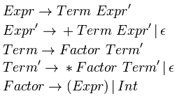
The above transformations remove left-recursion by creating a right-recursive grammar; but this changes the associativity of our rules. Left recursion makes left associativity; right recursion makes right associativity. Example : We start out with a grammar :
After having applied standard transformations to remove left-recursion, we have the following grammar :
Parsing the string 'a + a + a' with the first grammar in an LALR parser (which can recognize left-recursive grammars) would have resulted in the parse tree:

Slide 40
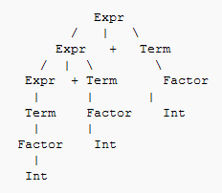
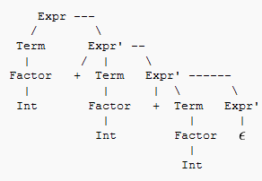
This parse tree grows to the left, indicating that the '+' operator is left associative, representing (a + a) + a.
But now that we've changed the grammar, our parse tree looks like this :

Slide 41
We can see that the tree grows to the right, representing a + ( a + a). We have changed the associativity of our operator '+', it is now right-associative. While this isn't a problem for the associativity of addition, it would have a significantly different value if this were subtraction.
The problem is that normal arithmetic requires left associativity. Several solutions are: (a) rewrite the grammar to be left recursive, or (b) rewrite the grammar with more nonterminals to force the correct precedence/associativity, or (c) if using YACC or Bison, there are operator declarations, %left, %right and %nonassoc, which tell the parser generator which associativity to force.

Slide 42
Expression Grammar Ambiguous non-Ambiguous No Left Rec
S → E
E → E + E
E → E – E
E → E * E
E → E / E
E → ( E )
E → num | id
S → E
E → E + T
E → E - T
E → T
T → T * F
T → T / F
T → F
F → ( E )
F → num | id
S → E
E → T E’
E’ → +T E’ | -T E’ | λ
T → FT’
T → * FT’ | / F T’| λ
F → ( E )
F → num | id
Notes:
42

Slide 43
Left Factoring
The grammar is unambiguous and non-left-recursion but we don't know which rule to apply on a symbol in:
S → VU₁
→ VU₂
→ VU₃
………………
→ VU_{n}
However, it can be factored as follows.
S → VB
B →U₁
→U₂
→U₃
………………
→ U_{n}
Notes:
43

Slide 44
Should we apply right factoring too?

